Slide 1
Welcome
to
Curriculum Night!
Notes:
Font – Hello Doodle Print & KG Second Chances

Slide 2
Second Grade Subjects

Slide 3
Religion
A community of faith is fostered through daily prayer, participation at Mass, Scripture stories, discussions, activities and games that promote care and respect for all people.
“Talking with God” is an archdiocesan assessment we will complete in the second semester.

Slide 4
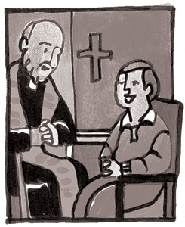
Sacraments
Reconciliation First Communion
* parent meeting * parent meeting Sun,
Sun, Sept 30 @ 7:15 pm Feb 3 @7:15 pm
* celebrate Dec. 4 at * celebrate March 31 at 7:00 pm 3:00 pm *breakfast Fri., April 5

Slide 5
Prayers to Know
* The Lord’s Prayer
* Hail Mary
* Act of Contrition
* Doxology (Glory Be)

Slide 6
Language Arts
McGraw Hill Reading Program integrates:
Reading/Literature
Writing
Phonics
Grammar
Spelling

Slide 7
Reading & Literature
New stories every week
Assessment on Friday
Skills: comprehension, decoding,
predicting, summarizing and drawing
conclusions
Practice fluency
Read with good expression,
smoothness and speed

Slide 8
Becoming a stronger, more independent reader takes a lot of practice!
Read at least 20 minutes every night.
Notes:
Our students listen to us read aloud, they are given many opportunities to practice reading, by themselves and with others. We encourage daily reading at home. This can be reading aloud, silent reading, or reading with a parent.
- Refer to 2nd to last page in packet (Why Can’t I Skip My Minutes of Reading Tonight)

Slide 9
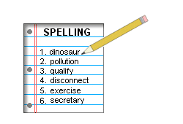
Spelling
15 words each week
Pre-test on Monday
Individualized lists
Test on Friday

Slide 10
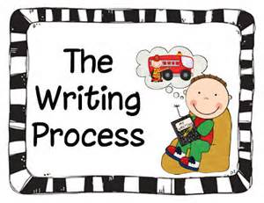
Writing
6 Traits of Writing
* Ideas
* Organization
* Voice
* Sentence Fluency
* Word Choice
* Conventions

Slide 11
Grammar
* Voyages in English by
Loyola Press
sentences, punctuation, parts of
speech, contractions, synonyms,
antonyms, homophones,
alphabetical order
Notes:
New book. Same skills, much more second grade friendly.

Slide 12
Math
* Basic addition/subtraction facts to 20
* Numbers into the thousands
* Add/subtract 3-digit numbers with regrouping
* Graphing
* Money
* Fractions
* Measurement
Time
* Introduction to multiplication and division

Slide 13
FASTTMath
Fluency and
Automaticity through
Systematic
Teaching with
Technology

Slide 14
Notes:
Facts are introduced in a systematic way. Differentiated because students are introduced to THEIR study facts each time they log on. Study facts are ones they are not yet fluent at. Once presented students get to choose a game from within the program to practice these facts along with any facts they have mastered. In games students aren’t given other facts they haven’t learned just those they know and the ones they are working on. This promoted mastery because it doesn’t let the student go on unless they memorize the facts they’ve already been given and doesn’t overwhelm them with too many new and unknown facts.

Slide 15
Social Studies
* Community
* Citizens
* Choosing
leaders
* Patriotic
symbols &
actions
* Maps & globes
* Natural
resources
* Life cycles
* Food chain
* Magnets
* Weather
* Rocks
* Solar System
* Seasons
* Health
Science

Slide 16
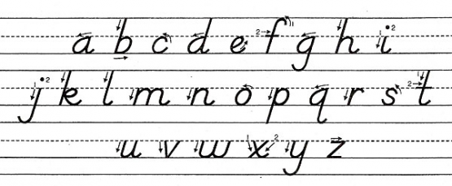
Handwriting
* D’Nealian style
* 1st semester: review manuscript
* 2nd semester: introduce and learn cursive

Slide 17
Sycamore
* our online grade reporting
system
* grades will be posted at least every
two weeks, if not more often

Slide 18
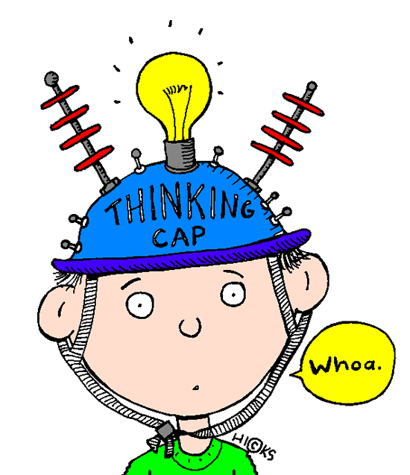
Homework
approximately 20 minutes per night
Minimum required:
* read assigned story or book
* FASTTMath once a week
* practice spelling words
Recommended:
* read every night
* daily math facts practice

Slide 19
Homework for week of September 3-7
REQUIRED: read story aloud _____
log on and do Fasttmath _____
practice spelling words _____
OPTIONAL:
read 20 minutes _____ _____ _____
practice math facts _____ _____ _____
play actively for 30 minutes _____
make up a prayer thanking God for your blessings_____
write detailed directions of how to get from home to school _____
practice writing your first and last name 5 times with GOOD D’Nealian handwriting _____
read the Creation story in the Bible___
Notes:
* Allows differentiation (already know spelling words after 1 practice then don’t log on to spellingcity); already know addition facts then work on subtraction; read a bible story at their reading level; already know the Hail Mary?? Easy one then. Need to learn it better it’s a reminder to work on it.

Slide 20
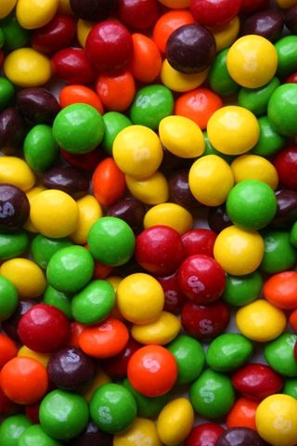
Treats
* Arrange with teacher ahead of time
* Individually wrapped/packaged
* No gum
Treats distributed at the end of the
day
* Avoid foods with nuts or made in a factory with nuts

Slide 21
Questions
or
Comments

Slide 22
Mrs. Angie Lowry
Email Address: a.lowry@stephen.org
Phone Number: 402-896-0754
Class Website: mrslowry.yolasite.com

